Slide 1

Operating Systems BCSC 0004
Process Management (1)

Slide 2

Books
Operating System Concepts Ninth Edition
Avi Silberschatz Peter Baer Galvin Greg Gagne
Operating Systems: Internals and Design Principles
William Stallings

Slide 3
Outlines…
Process Concept
Process States
Process State Transition Diagram
Process Control Block
Process Scheduling Concepts
Threads and their management

Slide 4
Process & Program
The term process was first used by the designers of the Multics in 1960’s
The process has been given many definition for instance
A program in execution .
An asynchronous activity
The entity to which process are assigned
Sequence of states during the execution of a program
The most frequently used def^{n} “Program in execution”
What is the relationship between process & Program?
It is the same beast with different name or when this beast is sleeping (not executing )called program and when it is executing becomes process.
Process is not same as program. A program is only part of process.

Slide 5
Process Operations
Create/terminate process
Change program
Set/get process parameters
Block process
Awaken process
Switch process
Schedule process
In process model all software on the computer is organised into a number of sequential processes.
A process include PC, Register and variables.
Conceptually each process has its own virtual CPU. In reality the CPU switches back and forth among process.

Slide 6
Process creation
In general purpose system, some way is needed to create processes as needed during operation.
There are four principle events led to process creation.
System initialization
Execution of a process creation system calls by a running process.
A user request to create a new process
Initialization of a batch job
Fore ground process interact with users
Background processes are processes that stay in background sleeping but suddenly springing to life to handle activity such as email ,webpage, printing and so on.

Slide 7
Process Termination
A process terminates when it finishes executing its last statements. Its resources are returned to the system and its process control block is erased and memory space is returned to a free memory pool.
The new process terminates existing process, usually due to following reasons.
Normal exit – process terminates bcz they have done their job.
Error exit – when process discover a fatal error.
Killed by another process – a process executes a system call telling the operating system to terminate some other process. In UNIX this call is kill.

Slide 8
Process State
As a process executes, it changes state
New: The process is being created
Running: Instructions are being executed
Waiting: The process is waiting for some event to occur
Ready: The process is waiting to be assigned to a process
Terminated: The process has finished execution

Slide 9
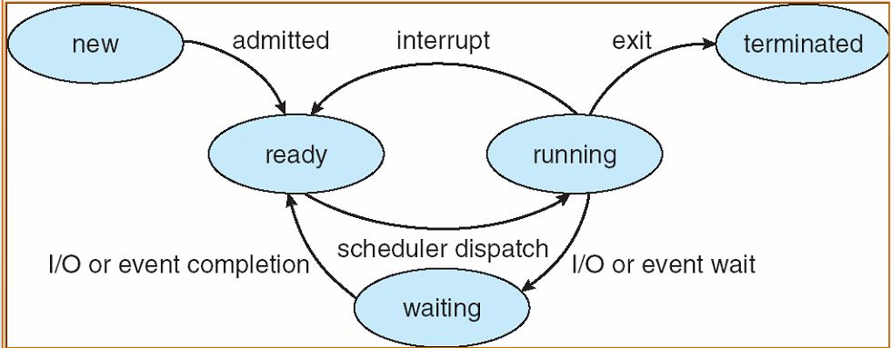
Process state transition Diagram

Slide 10
Process Control Block (PCB)
A process in an operating system is represented by a data structure known as a process control block.
The PCB contains important information about the specific process including
Process state
Program counter
CPU registers
CPU scheduling information
Memory-management information
Accounting information
I/O status information

Slide 11
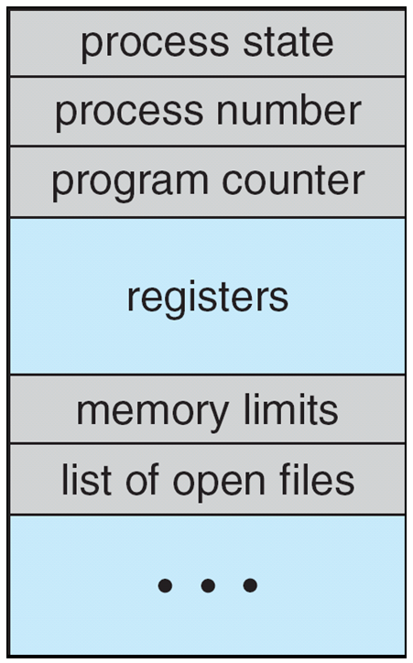
Process Control Block (PCB)
Information associated with each process
(also called task control block)
Process state – running, waiting, etc
Program counter – location of instruction to next execute
CPU registers – contents of all process-centric registers
CPU scheduling information- priorities, scheduling queue pointers
Memory-management information – memory allocated to the process
Accounting information – CPU used, clock time elapsed since start, time limits
I/O status information – I/O devices allocated to process, list of open files

Slide 12
Process Table
One entry for each process
Some typical data:
Saved registers
Process state
Process ID
Owner/group ID
Priority
Memory usage
Open files

Slide 13
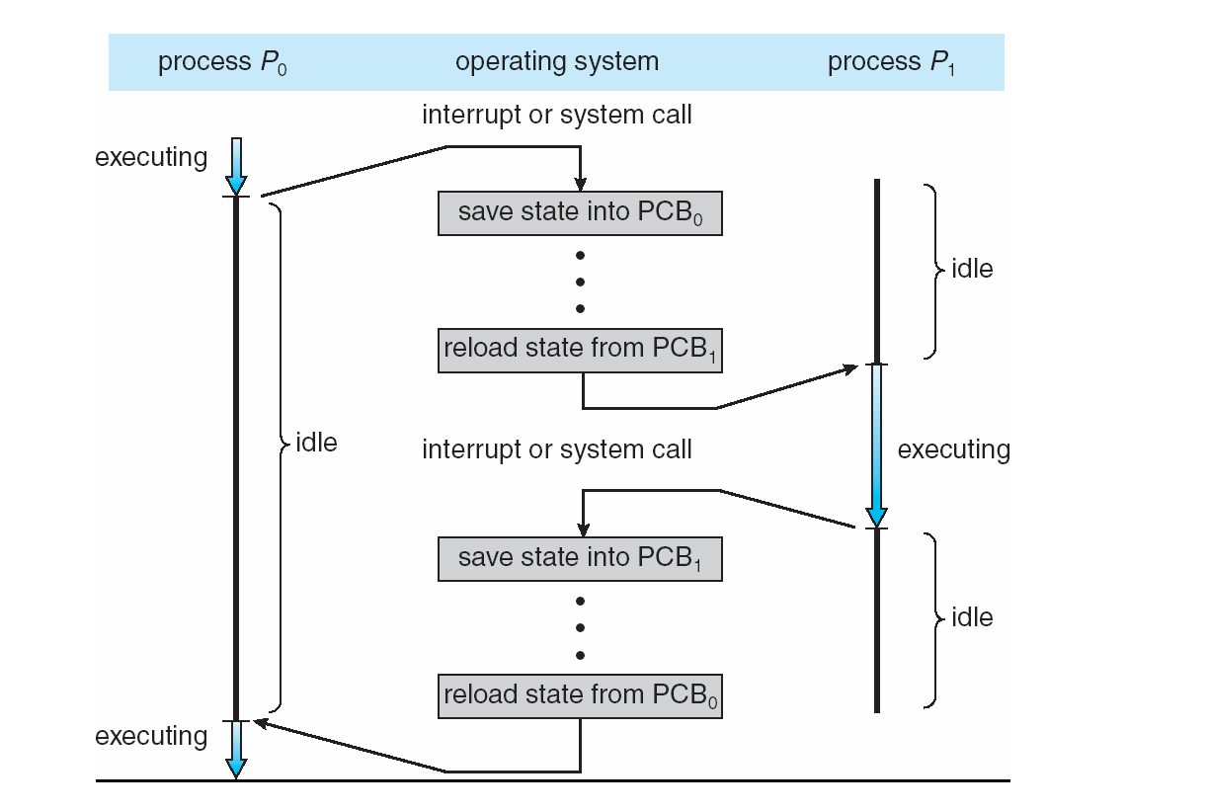
CPU Switch From Process to Process

Slide 14
Threads (1)
Despite of fact that a thread must execute in processes, the processes and its associated threads are different concept.
Process are used to group resources together and threads are the entities scheduled for execution on the CPU.
A thread is a single sequence stream within in a process. Bcz threads have some of the properties of processes, they are sometime called light weight processes.
In a process, threads allows multiple executions of streams. In many respect, threads are popular way to improve application through parallelism.
The CPU switches rapidly back and forth among the threads giving illusion that the threads are running in parallel.

Slide 15
Threads (2)
Process with one thread, a thread can be in any of several states(running, blocked, ready or terminated).
Each thread has its own stack.
An O.S. that has threads facility the basic unit of CPU utilization is thread.
A thread has a program counter , a register set and a stack space.
Thread are not independent of one another like processes: as a result threads share with other thread their code section, OS resources also known as task such as open files and signals.

Slide 16
Why threads
Following are some reason why we use thread in designing operating system.
A process with multiple threads make a great server for example printer server
Bcz threads can share common data they do not use inter- process communication.
Bcz of the vary nature, threads can take advantage of multiprocessors.
Threads are very little resources of an O.S in which they are working. i.e. thread do not need new address space, global data, program code, or O.S resources.
Context switching are fast when working with threads . The reason is that we only have to save and/or restore PC, SP & register.

Slide 17
Context switch
To give each process on a multi programmed machine a fair share of the CPU, a hardware clock generates interrupts periodically.
This allows the O.S to schedule all processes in main memory (using scheduling algorithm) to run on the CPU at equal intervals.
Each time a clock interrupt occurs, the interrupts handler checks how much time the current running process has used.
If it has used up its entire time slice the CPU scheduling algorithm
In kernel picks a different process to run. Each switch of the CPU from one process to another it called a context switch.

Slide 18
Major step of context switching
The value of the CPU registers are saved in the process table of the process that was running just before the clock interrupt occurred.
The register are loaded from the process picked up by the CPU scheduler to run next.
In a multi programmed processor computing system, context switches occur frequently enough that all processes appear to be running concurrently.
If a process has more than one thread, the O.S can use the context switching technique to schedule the threads so that they appear to execute parallel.

Slide 19
CPU Process scheduling
The problem of determining when processor should be assigned and to which processes is called processor scheduling or CPU scheduling.
When more than one process is run able the O.S must decide which one first.
The part of O.S. concerned with this decision is called the scheduler and algorithm it uses the called scheduling algorithms.
Select the next process to run
Consider processes in the ready state
Approaches different for batch systems and for time-sharing systems

Slide 20
Process Scheduling
Maximize CPU use, quickly switch processes onto CPU for time sharing
Process scheduler selects among available processes for next execution on CPU
Maintains scheduling queues of processes
Job queue – set of all processes in the system
Ready queue – set of all processes residing in main memory, ready and waiting to execute
Device queues – set of processes waiting for an I/O device
Processes migrate among the various queues

Slide 21
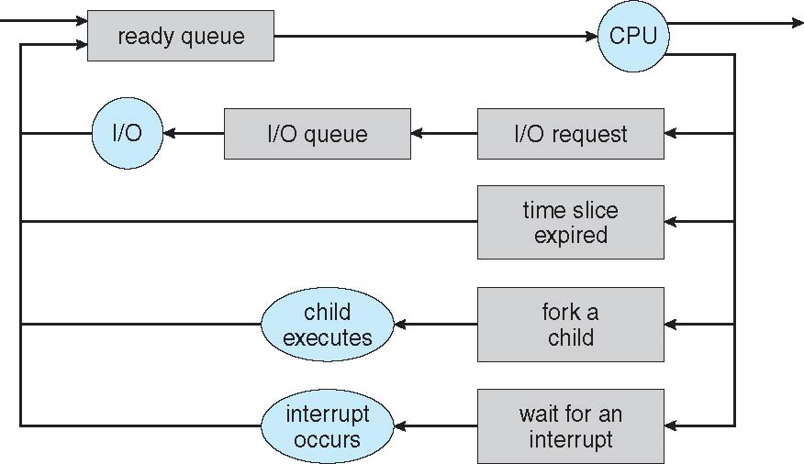
Representation of Process Scheduling
Queueing diagram represents queues, resources, flows

Slide 22
Schedulers
Short-term scheduler (or CPU scheduler) – selects which process should be executed next and allocates CPU
Sometimes the only scheduler in a system
Short-term scheduler is invoked frequently (milliseconds) ⇒ (must be fast)
Long-term scheduler (or job scheduler) – selects which processes should be brought into the ready queue
Long-term scheduler is invoked infrequently (seconds, minutes) ⇒ (may be slow)
The long-term scheduler controls the degree of multiprogramming
Processes can be described as either:
I/O-bound process – spends more time doing I/O than computations, many short CPU bursts
CPU-bound process – spends more time doing computations; few very long CPU bursts
Long-term scheduler strives for good process mix

Slide 23
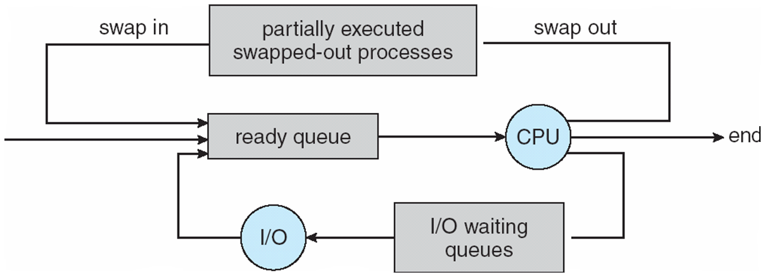
Addition of Medium Term Scheduling
Medium-term scheduler can be added if degree of multiple programming needs to decrease
Remove process from memory, store on disk, bring back in from disk to continue execution: swapping

Slide 24
CPU Scheduling or Process scheduling
Basic Concepts
Scheduling Criteria
Scheduling Algorithms
Thread Scheduling
Multiple-Processor Scheduling
Real-Time CPU Scheduling
Operating Systems Examples
Algorithm Evaluation

Slide 25
Objectives
To introduce CPU scheduling, which is the basis for multiprogrammed operating systems
To describe various CPU-scheduling algorithms
To discuss evaluation criteria for selecting a CPU-scheduling algorithm for a particular system
To examine the scheduling algorithms of several operating systems

Slide 26
Basic Concepts
Maximum CPU utilization obtained with multiprogramming
CPU–I/O Burst Cycle – Process execution consists of a cycle of CPU execution and I/O wait
CPU burst followed by I/O burst
CPU burst distribution is of main concern

Slide 27
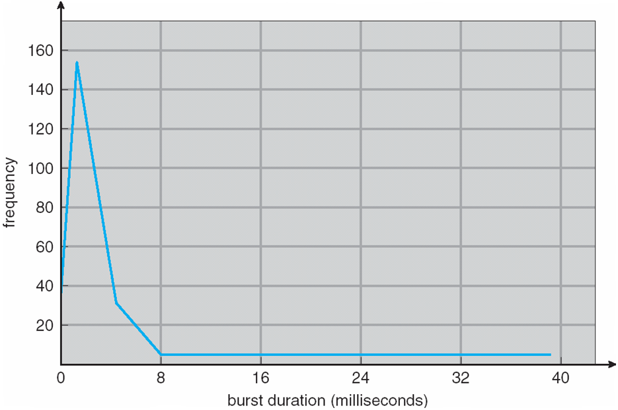
Histogram of CPU-burst Times

Slide 28
Type of Scheduling
Scheduling algorithm can be divided into two categories with respect to how they deal with clock interrupt.
Non Preemptive scheduling
Short jobs are made to wait by longer jobs but the overall treatment of all processes is fair.
Response time are more predictable bcz incoming high priority jobs can not displace waiting jobs.
Preemptive scheduling
A scheduling discipline is preemptive if once a process has been given the CPU, it can be taken away.

Slide 29
CPU Scheduler
Short-term scheduler selects from among the processes in ready queue, and allocates the CPU to one of them
Queue may be ordered in various ways
CPU scheduling decisions may take place when a process:
1. Switches from running to waiting state
2. Switches from running to ready state
3. Switches from waiting to ready
Terminates
Scheduling under 1 and 4 is nonpreemptive
All other scheduling is preemptive
Consider access to shared data
Consider preemption while in kernel mode
Consider interrupts occurring during crucial OS activities

Slide 30
CPU scheduling
A process execution consist of a cycle of CPU execution and I/O execution.
Normally every process begin with CPU burst that may be followed by I/O burst, then another CPU burst then I/O burst and so on. Eventually in the last will end up on CPU burst.
CPU bound process: These are those processes which require most of time on CPU.
I/O bound process: These are those processes which require most of time on I/O devices.
A good scheduling idea should choose the mixture of both so that both I/O device and CPU can be utilized efficiently.

Slide 31
Scheduling Criteria CPU scheduling terminology
CPU utilization – keep the CPU as busy as possible
Throughput – # of processes that complete their execution per time unit
Burst time/ execution time/ running time: is the time process require for running on CPU
Waiting time: time spend by a process in ready state waiting for CPU
Arrival time: when a process enter the ready state
Exit time: when process completes execution and exit from system
Turn around time: total time spend by a process in the system
TAT = ET – AT or BT + WT
Response time: Time between a process enter ready queue and get scheduled on the CPU for the first time

Slide 32
Scheduling Criteria for algorithms
Average waiting time
Average response time
CPU Utilization
Throughput

Slide 33
Scheduling Algorithm Optimization Criteria
Max CPU utilization
Max throughput
Min turnaround time
Min waiting time
Min response time

Slide 34
First- Come, First-Served (FCFS) Scheduling
Simplest scheduling algorithm, it assign CPU to the process which arrives first.
Easy to understand and can easily be implemented using queue data structure.
Always non-pre-emptive in nature.

Slide 35
Process Id | Arrival time | Burst time
A | 3 | 4
B | 5 | 3
C | 0 | 2
D | 5 | 1
E | 4 | 3

Slide 36
Process Id | Arrival time | Burst time | Turn around time | Waiting Time
A | 3 | 4 | 4 | 0
B | 5 | 3 | 8 | 5
C | 0 | 2 | 2 | 0
D | 5 | 1 | 9 | 8
E | 4 | 3 | 6 | 3

Slide 37
Process Burst Time
P₁ 24
P₂ 3
P₃ 3
Suppose that the processes arrive in the order: P₁ , P₂ , P₃ The Gantt Chart for the schedule is:
Waiting time for P₁ = 0; P₂ = 24; P₃ = 27
Average waiting time: (0 + 24 + 27)/3 = 17

Slide 38
Convoy effect: smaller process have to wait for long time for bigger process to release CPU.
Advantage: simple, easy to use, easy to understand, easy to implement, must be used for background process where execution is not urgent.
Disadvantage: Suffer from convoy effect, normally higher average waiting time, no consideration to priority or burst time, should not be used for interactive system.
PID | AT | BT
A | 0 | 100
B | 1 | 1
PID | AT | BT
A | 1 | 100
B | 0 | 1

Slide 39
Shortest Job First (SJF non-pre-emptive)/ Shortest Remaining Time First (SRTF Pre-emptive)
Out of all available process, CPU is assigned to the process having smallest burst time requirement (no priority, no seniority)
If there is a tie, FCFS is used to break tie
Can be used both with non-pre-emptive and pre-emptive approach
Pre-emptive version (SRTF) is also called as optimal as it gurantee minimal average waiting time.

Slide 40
Pid | AT | BT | Non-pre-emptive |  | Pre-emptive
 |  |  | TAT | WT | TAT | WT
A | 3 | 1 | 4 | 3 | 1 | 0
B | 1 | 4 | 15 | 11 | 5 | 1
C | 4 | 2 | 5 | 3 | 4 | 2
D | 0 | 6 | 6 | 0 | 16 | 10
E | 2 | 3 | 10 | 7 | 9 | 6

Slide 41
Shortest Job First (SJF non-pre-emptive)/ Shortest Remaining Time First (SRTF Pre-emptive)
Advantage: SRTF guarantees minimal average waiting time.
Provide a standard for other algorithm in terms of average waiting time.
Better average response time compare to FCFS
Disadvantage: Algorithm can not be implemented as there is no way to know the burst time of a process.
Process with longer CPU burst time requirement will go into starvation.
No idea of priority, process with large burst time have poor response time.

Slide 42
Determining Length of Next CPU Burst
Can only estimate the length – should be similar to the previous one
Then pick process with shortest predicted next CPU burst
Can be done by using the length of previous CPU bursts, using exponential averaging
Commonly, α set to ½
Preemptive version called shortest-remaining-time-first

Slide 43
Prediction of the Length of the Next CPU Burst

Slide 44
Priority Scheduling Algorithm
Here a priority is associated with each process.
At any instance of time out of all available process, CPU is allocated to the process which process the highest priority (Number may be higher or lower).
Tie is broken using FCFS order.
No importance of arrival time or burst time.
Support both non-preemptive and preemptive version.

Slide 45
Priority Scheduling Algorithm
A priority number (integer) is associated with each process
The CPU is allocated to the process with the highest priority (smallest integer ≡ highest priority)
Preemptive
Nonpreemptive
SJF is priority scheduling where priority is the inverse of predicted next CPU burst time
Problem ≡ Starvation – low priority processes may never execute
Solution ≡ Aging – as time progresses increase the priority of the process

Slide 46
Pid | AT | BT | Priority | Non-pre-emptive |  | Pre-emptive
 |  |  |  | TAT | WT | TAT | WT
A | 0 | 4 | 2 | 4 | 0 | 15 | 11
B | 1 | 3 | 3 | 14 | 11 | 11 | 8
C | 2 | 1 | 4 | 10 | 9 | 1 | 0
D | 3 | 5 | 5 | 6 | 1 | 5 | 0
E | 4 | 2 | 5 | 7 | 5 | 6 | 4

Slide 47
Round Robin (RR)
Each process gets a small unit of CPU time (time quantum q), usually 10-100 milliseconds. After this time has elapsed, the process is preempted and added to the end of the ready queue.
If there are n processes in the ready queue and the time quantum is q, then each process gets 1/n of the CPU time in chunks of at most q time units at once. No process waits more than (n-1)q time units.
Timer interrupts every quantum to schedule next process
Performance
q large ⇒ FIFO
q small ⇒ q must be large with respect to context switch, otherwise overhead is too high

Slide 48
Example of RR with Time Quantum = 4
Process Burst Time
P₁ 24
P₂ 3
P₃ 3
The Gantt chart is:
Typically, higher average turnaround than SJF, but better response
q should be large compared to context switch time
q usually 10ms to 100ms, context switch < 10 usec

Slide 49
Advantage:
Perform best in terms of average response time.
Works will in case of time sharing system, client server architecture and interactive system.
Implemented with a circular queue
Kind of SJF implementation.
Disadvantage:
Longer process may starve
Performance depends heavily on time quantum
No idea of priority

Slide 50
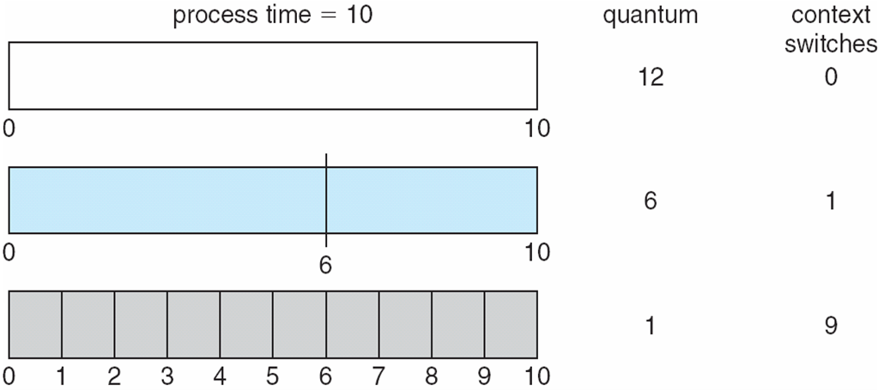
Time Quantum and Context Switch Time

Slide 51
Multilevel Queue
Ready queue is partitioned into separate queues, eg:
foreground (interactive)
background (batch)
Process permanently in a given queue
Each queue has its own scheduling algorithm:
foreground – RR
background – FCFS
Scheduling must be done between the queues:
Fixed priority scheduling; (i.e., serve all from foreground then from background). Possibility of starvation.
Time slice – each queue gets a certain amount of CPU time which it can schedule amongst its processes; i.e., 80% to foreground in RR
20% to background in FCFS

Slide 52
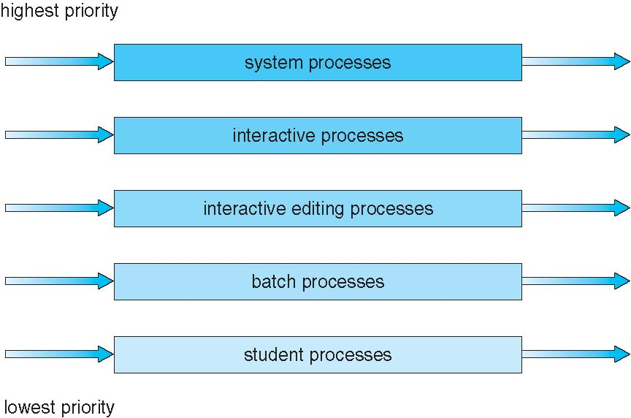
Multilevel Queue Scheduling

Slide 53
Multilevel Feedback Queue
A process can move between the various queues; aging can be implemented this way
Multilevel-feedback-queue scheduler defined by the following parameters:
number of queues
scheduling algorithms for each queue
method used to determine when to upgrade a process
method used to determine when to demote a process
method used to determine which queue a process will enter when that process needs service

Slide 54
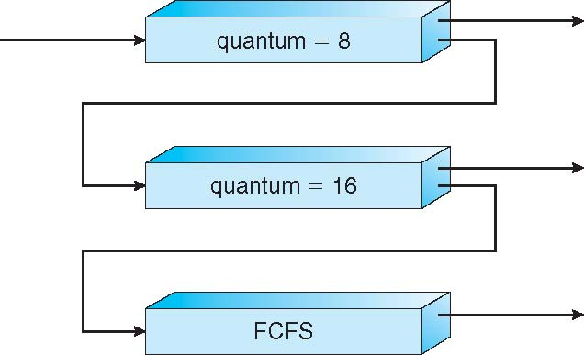
Example of Multilevel Feedback Queue
Three queues:
Q₀ – RR with time quantum 8 milliseconds
Q₁ – RR time quantum 16 milliseconds
Q₂ – FCFS
Scheduling
A new job enters queue Q0 which is served FCFS
When it gains CPU, job receives 8 milliseconds
If it does not finish in 8 milliseconds, job is moved to queue Q1
At Q1 job is again served FCFS and receives 16 additional milliseconds
If it still does not complete, it is preempted and moved to queue Q2

Slide 55
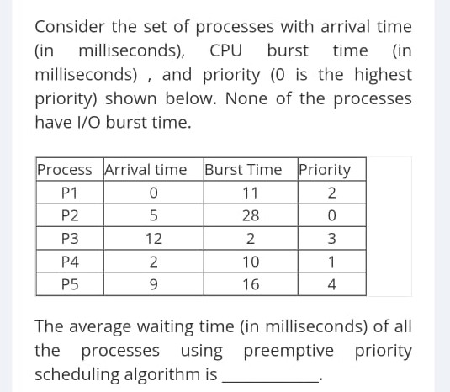

Slide 56
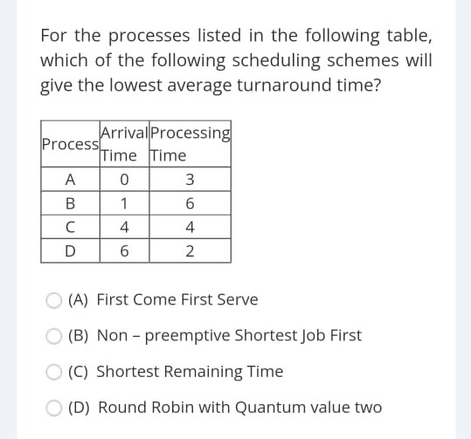

Slide 57
Q1. Three process P1, P2 and P3 arrive at time zero. The total time spent by the process in the system is 10ms, 20ms, and 30ms respectively. They spent first 20% of their execution time in doing I/O and the rest 80% in CPU processing. What is the percentage utilization of CPU using FCFS scheduling algorithm?
Process | Execution time | I/O time | CPU time
P1 | 10 | 2 | 8
P2 | 20 | 4 | 16
P3 | 30 | 6 | 24

Slide 58
Q2. Three process p1, P2 and P3 arrive at time zero. Their total execution time is 10ms, 15ms, and 20ms respectively. They spent first 20% of their execution time in doing I/O, next 60% in CPU processing and the last 20% again doing I/O. For what percentage of time was the CPU free? Use Round robin algorithm with time quantum 5ms.
Process | Execution time | I/O burst | CPU burst | I/O Burst
P1 | 10 | 2 | 6 | 2
P2 | 15 | 3 | 9 | 3
P3 | 20 | 4 | 12 | 4

Slide 59
Process Synchronization
Two types
Independent process: Execution of the process does not affect the execution of other.
Cooperative process: Execution of one process affects the execution of other process.
Critical Section: When more than one processes access a same code segment that segment is known as critical section. Critical section contains shared variables or resources which are needed to be synchronized to maintain consistency of data variable.

Slide 60
Race condition
In O.S. the processes that are working together shared some common storage (main memory file) that each process can read and write when two or more processes are reading or writing some shared data and the final result depend on who run precisely when, are called race conditions.
Concurrently executing threads that share data need to synchronize their operations and processing in order to thread at a time should be allowed to examine and update the shared variables.
Race condition are also possible in O.S. if the ready queue is implemented as a linked list and if the ready queue is manipulated during the handling of other interrupt before the first one completes. If the interrupts are not disable then the linked list could become corrupted.

Slide 61
How to avoid race condition?
The key to preempting trouble involving shared storage is to find some way to prohibit more than one process from reading and writing shared data simultaneously.
That part of the program where the shared memory is accessed is called the critical section.
To avoid race conditions and flowed results one must identify codes in critical section in each thread.

